Slide 1
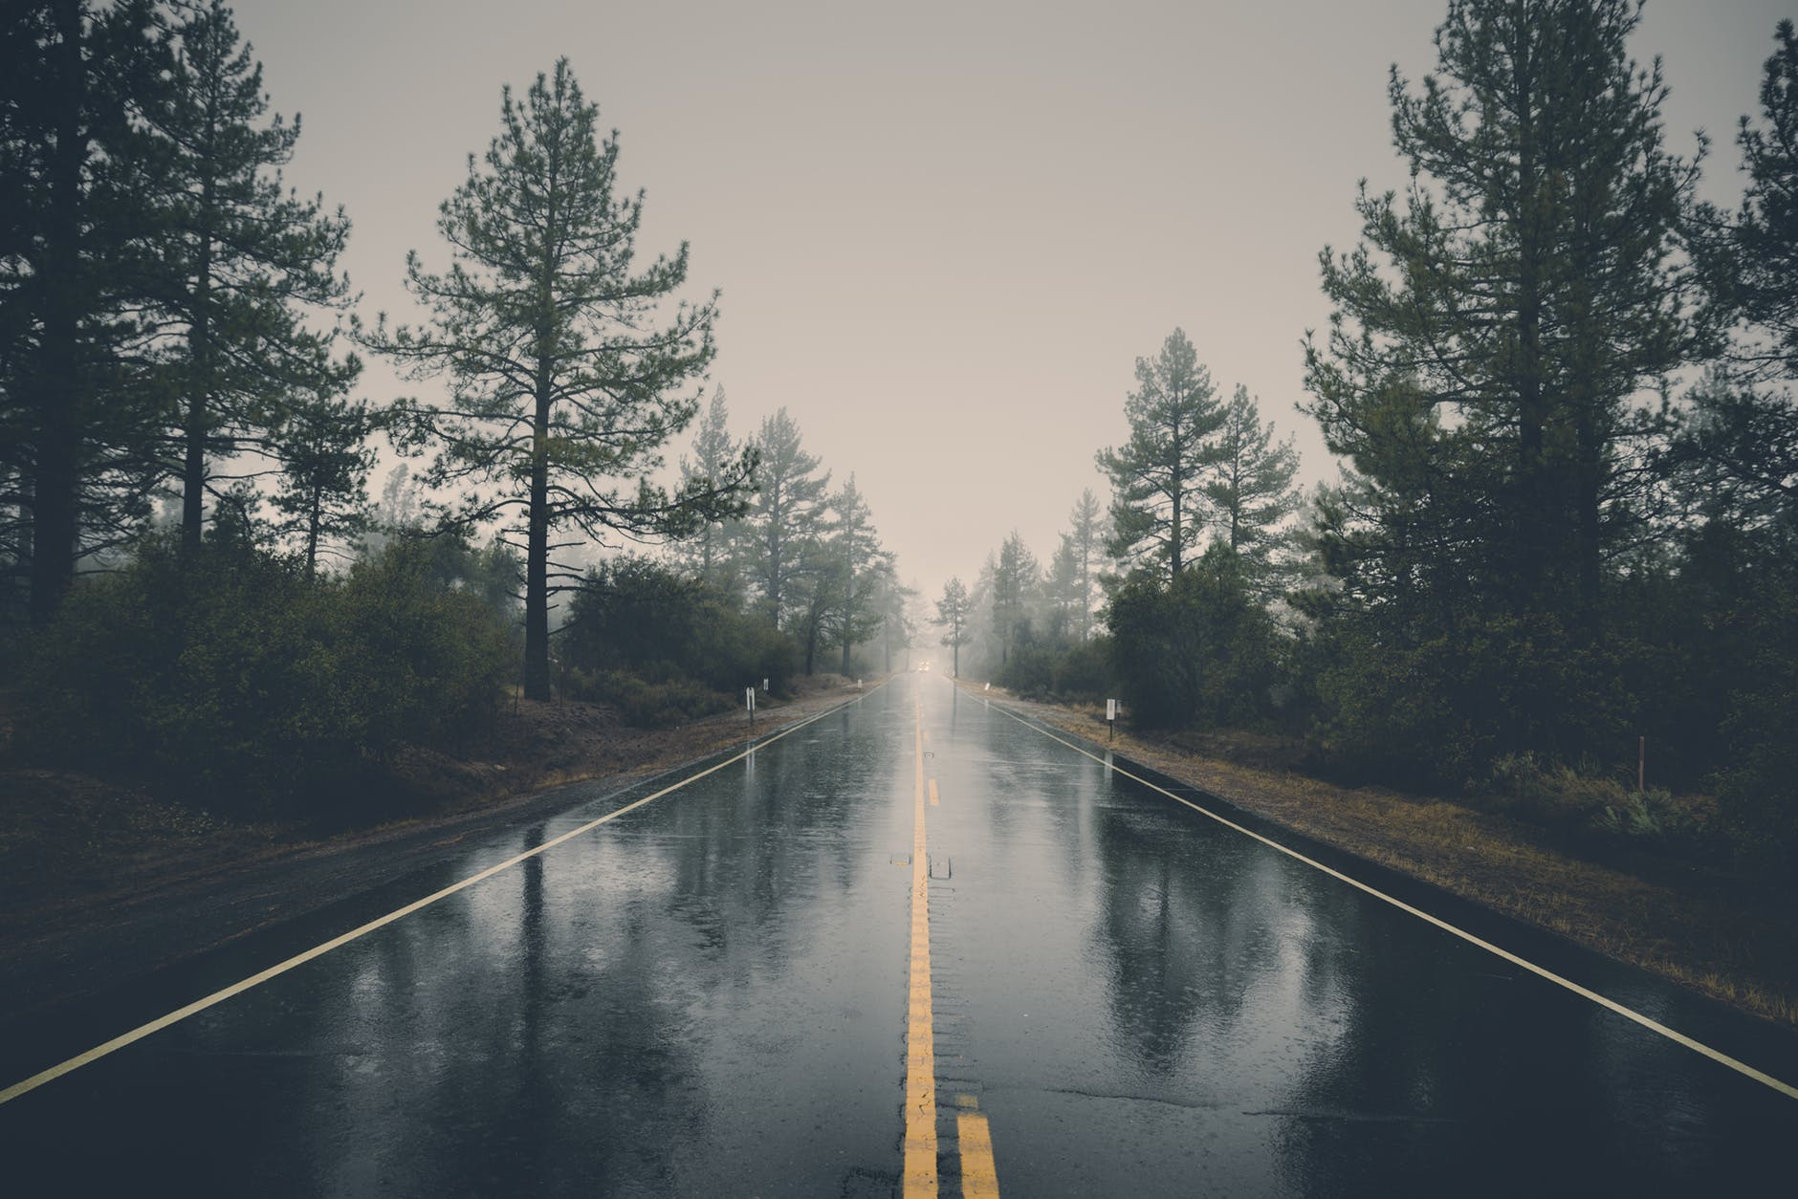



Slide 2
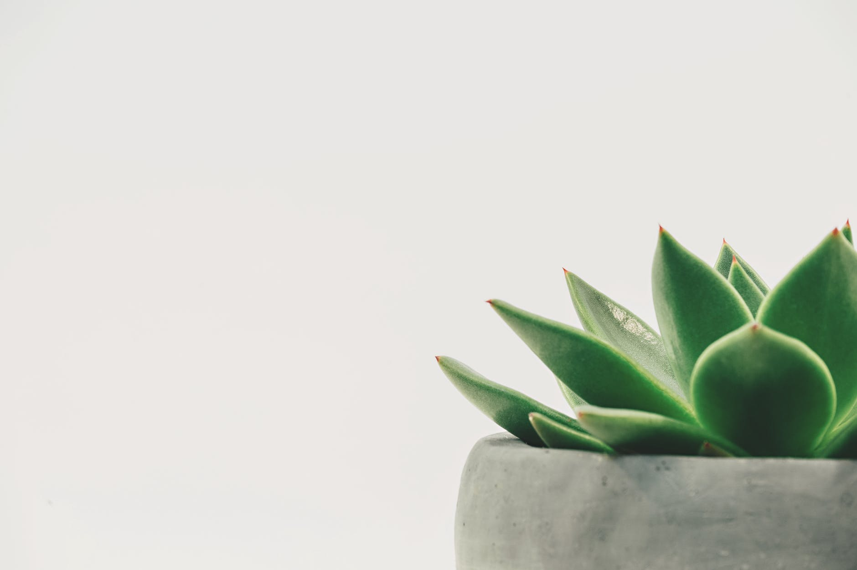
Everything originated from nature is original and natural

Slide 3

Original
present or existing from the beginning;
first or earliest.
Synthetic
made by chemical synthesis, especially to imitate a natural product.

Slide 4
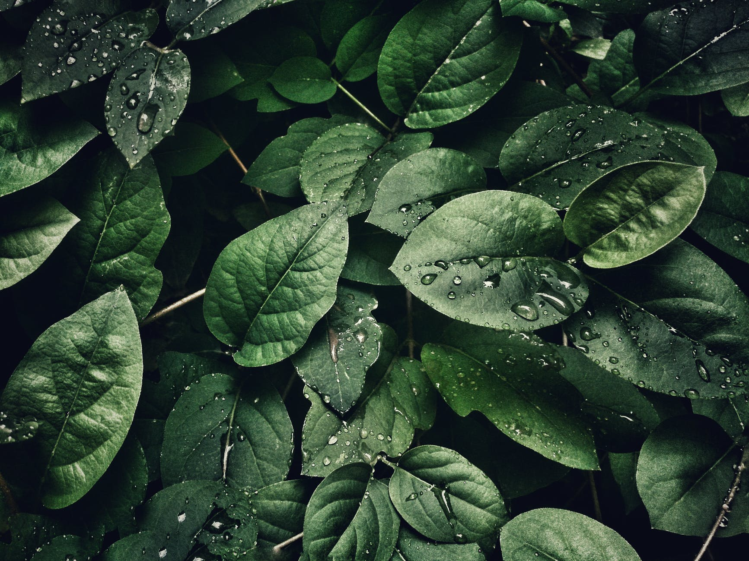
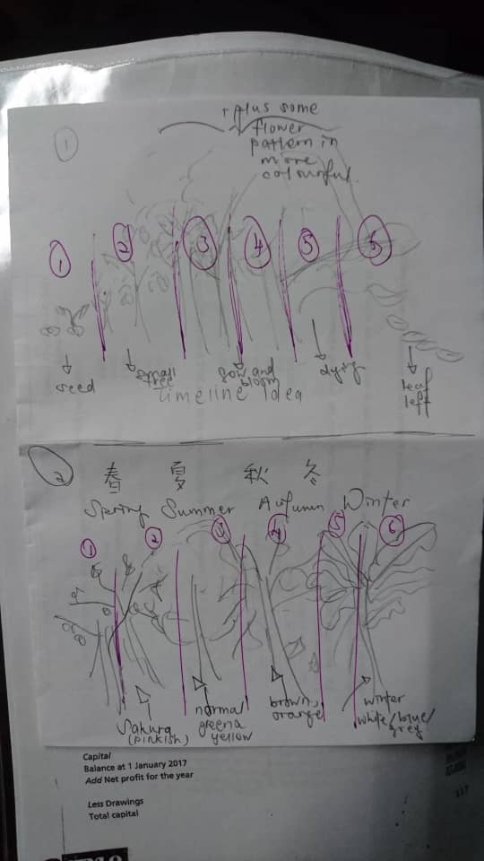
T-Shirt IDEA:
Life cycle of a tree
It is important for us to appreciate the little greens that we are destroying day by day unconsciously

Slide 5
We can produce many products that extracts nature’s goods.

Slide 6
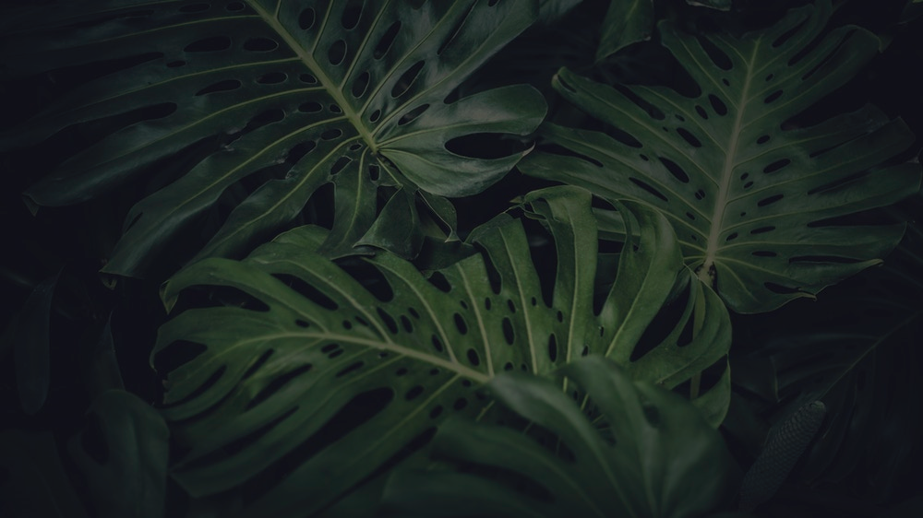
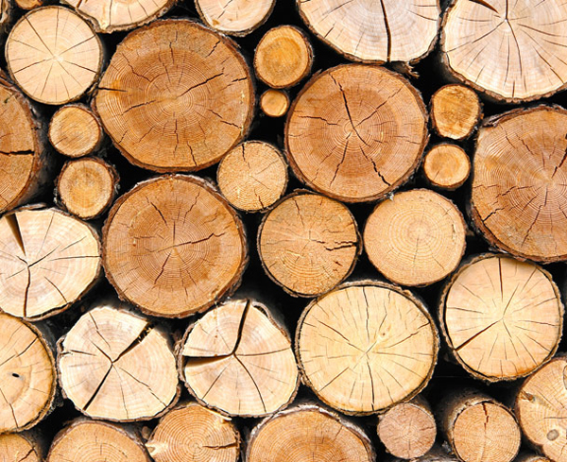
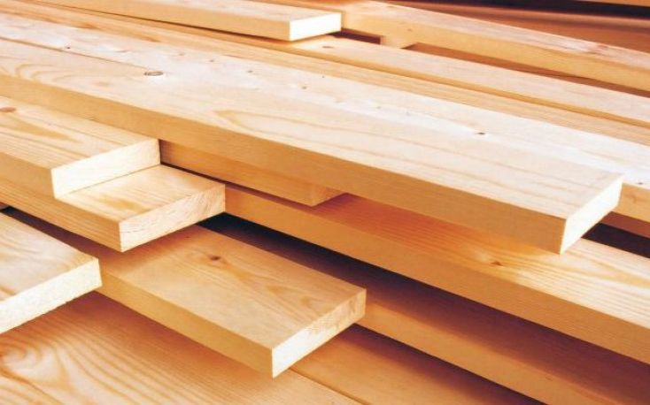
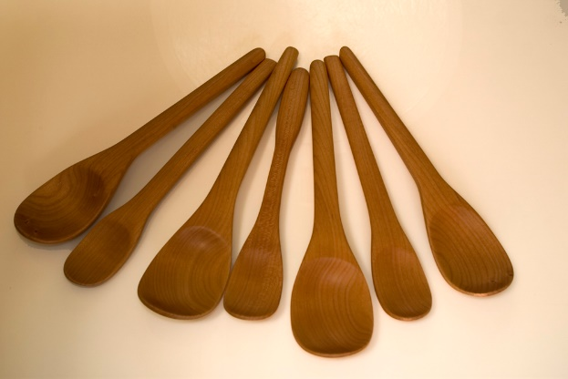
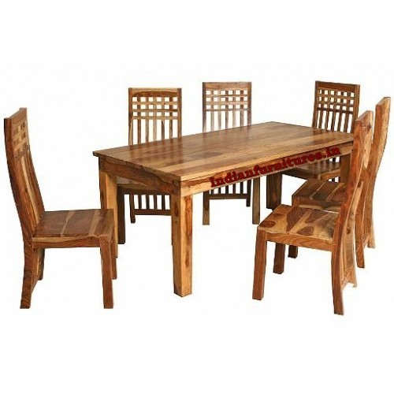
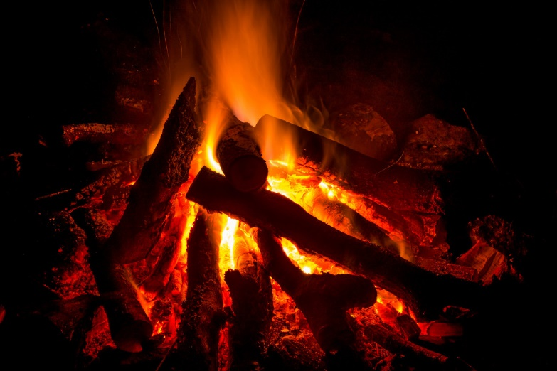
For example:

Slide 7
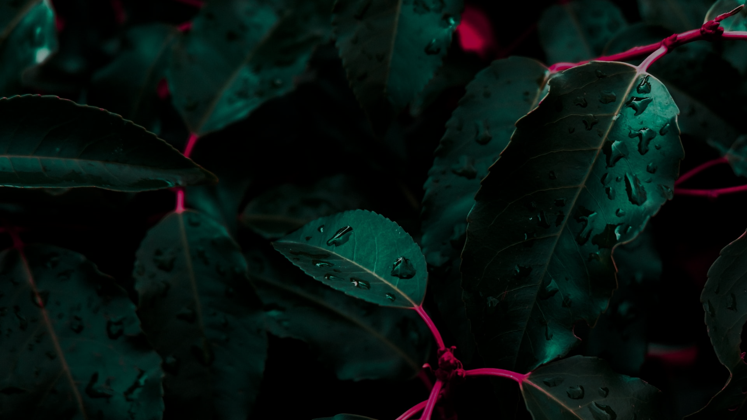
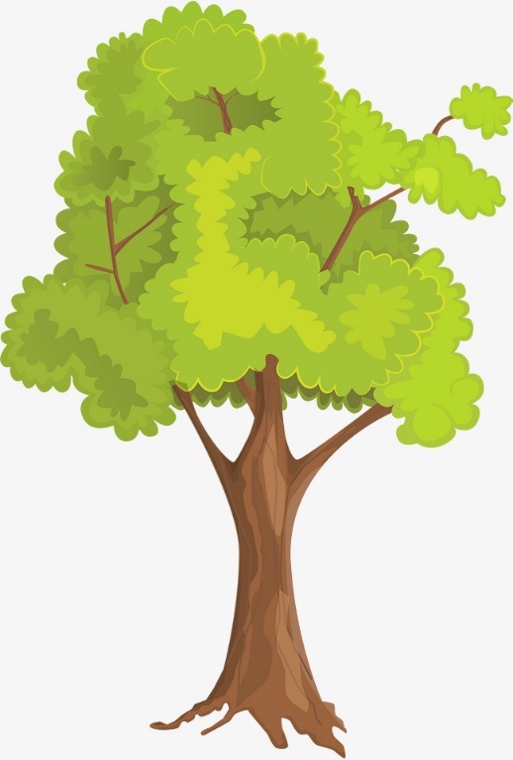
Cellulose
Resin
Rubber

Slide 8
In Conclusion
we can see that without nature, synthetic products would not exist even with the help of man-made elements.

Slide 9
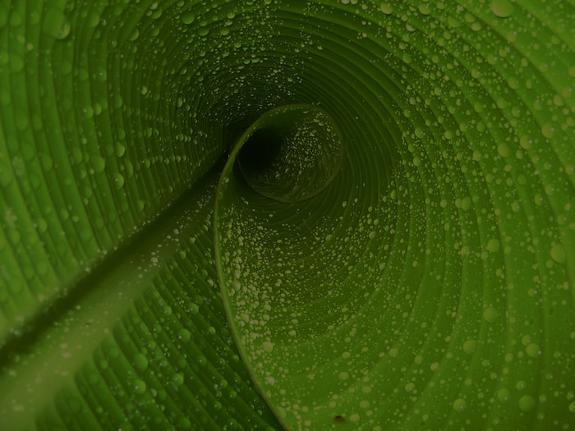

-THE END-
THANK YOU FOR YOUR TIME!

